Slide 1
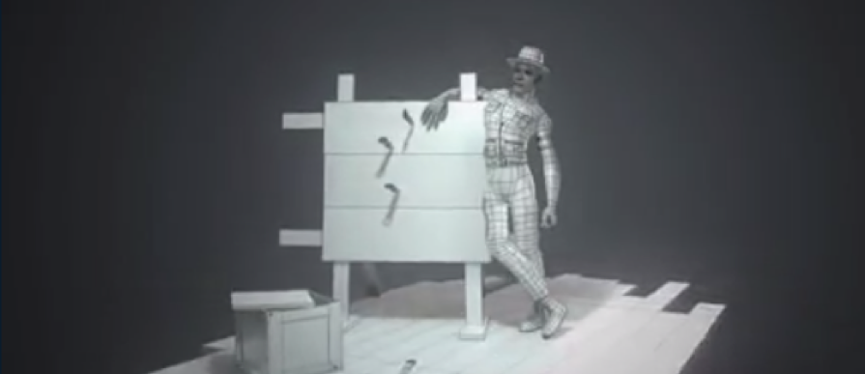
Workshop 2

Slide 2
Project
Using one of the assets created in Workshop 1, choose an activity in a playground and animate the character/s supplied to use the asset i.e. swings, see-saw, roundabout etc
You may want to start by having a character sitting on the swing and another character pushing the swing
Remember the final animation will include all playground equipment created, being used by the characters as chosen by the student.

Slide 3
Environment
Up until now you have created individual assets as separate scenes in Blender
Its time to start thinking about how your Playground will look as a completed environment with all the animated equipment which you will be importing into your final environment
Will it be a school type playground or a woodland adventure style playground?

Slide 4
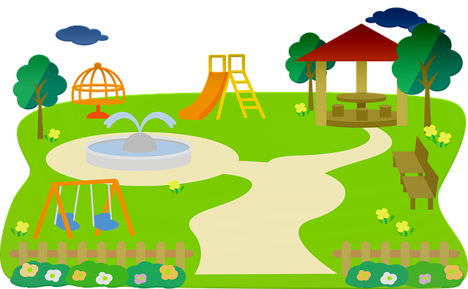
Animations
Build up your asset library to ensure you have a nice looking playground!

